Slide 1
A Multi-host File Synchronizer
TEAM : Benediction
1846353 Jihye Hwang

Slide 2
Contents
Project description
Team’s Aims
Project Organisation
Process and Tool

Slide 3
Desktop Client
Architecture
UI Design
Progress

Slide 4
Architecture for Desktop Client
Electron as main fra-mework
Rendering windows with Blink.
Windows are built by HTML, CSS, JS
Connecting operating system with Node.js module.
(Source: www.smashingmagazine.com/2017/03/beyond-browser-web-desktop-apps/)

Slide 5
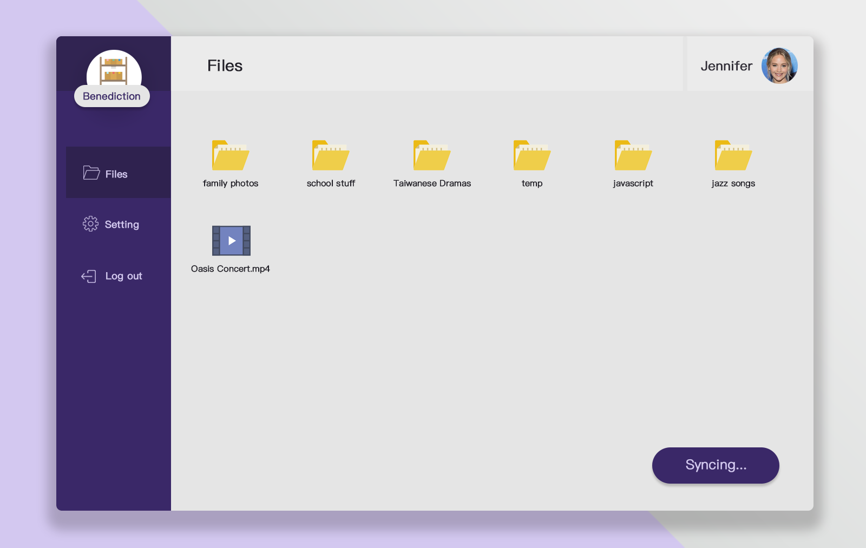
UI Design for Desktop Client

Slide 6
UI Design for Desktop Client
Current view title
Account info
Current view
Navigation bar
Status

Slide 7
UI Design for Desktop Client
Navigation bar: to navigate through different features/views
Current view title: to show which feature/view the user is using
Current view: the main container for main feature operation
Account information: to access account-related functions
Status indicator: to show the status of the application

Slide 8
Progress for Desktop Client
GUI implemented
Will integrate React.js to increase the readability and maintain-ability
Will use Node.js modules to integrate the backend synchronization

Slide 9
Contents

Slide 10
Contents

Slide 11
Contents

Slide 12
Contents

